Slide 1

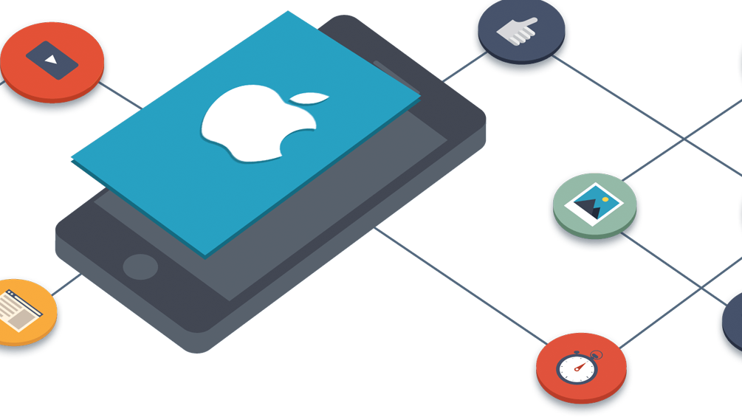
iOS developer
Made by Yerdaulet alipbayev

Slide 2
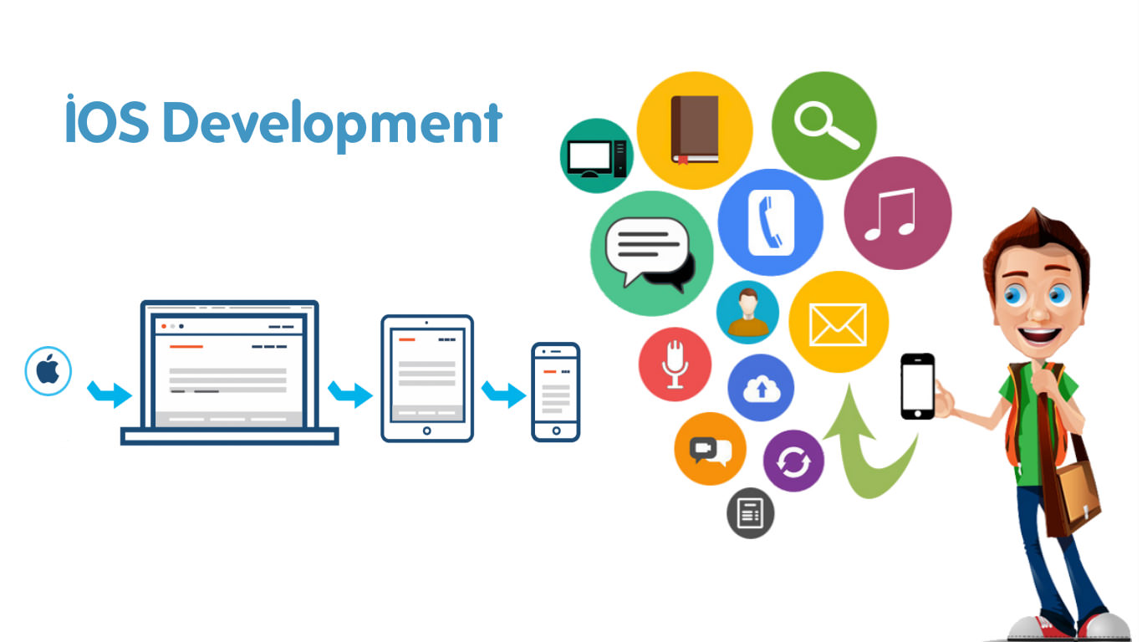

Slide 3
OVERVIEW
iOS developers make design and write considered algorithms
Research new updates and features to use these in their projects
Necessary to have Apple product like MacBook
Knowing programming languages as Swift or Objective-C

Slide 4

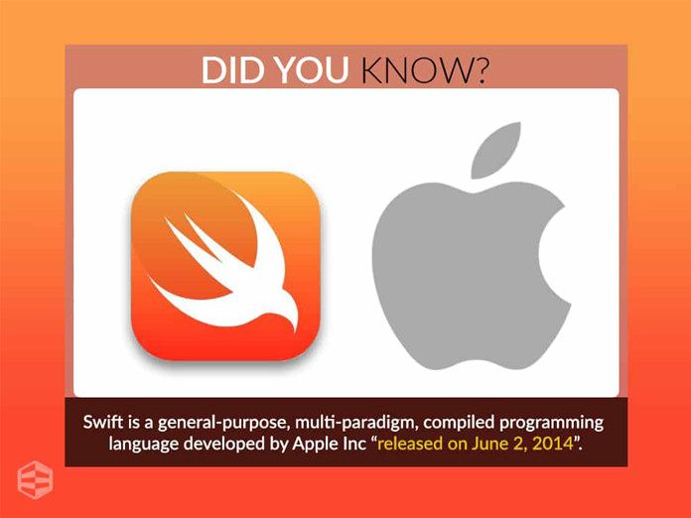

Slide 5
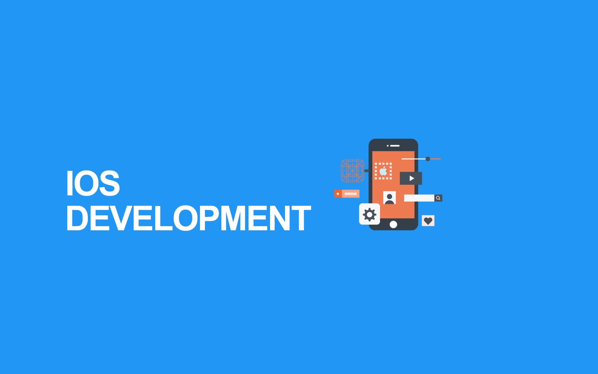
Required qualifications
Computer science
Information Systems
Applied software engineering
Information security systems

Slide 6

salary
According to yvision.kz the average salary of iOS developers in Kazakhstan is 250 000-300 000 tenge per month.

Slide 7

Chriss Lattner
CREATOR OF SWIFT AND XCODE
WORKED FOR MICROSOFT, APPLE, TESLA
CURRENTLY WORKING FOR GOOGLE BRAIN
DEVELOPED TESLA AUTOPILOT
KRASAVCHIK

Slide 8

CODEBUSTERS
WAS FOUND MAY, 2017
CREATORS OF “GETCONTACT_” WHICH BECOME “POOTIN” LATER
CONSISTS OF MOST POWERFUL PROGRAMMERS OF KAZAKHSTAN
ZVERI

Slide 9
My reflection(+)
LEARNED A LOT OF NEW WORDS
UNDERSTOOD WHAT IOS DEVELOPMENT MEANS
IT WAS FUNNY☺

Slide 10
MY REFLECTION(-)
FINDING CORRECT INFORMATION
OF COURSE, APA STYLE AND REFERENCES)
IOS DEVELOPMENT IS NOT POPULAR IN OUR COUNTRY

Slide 11
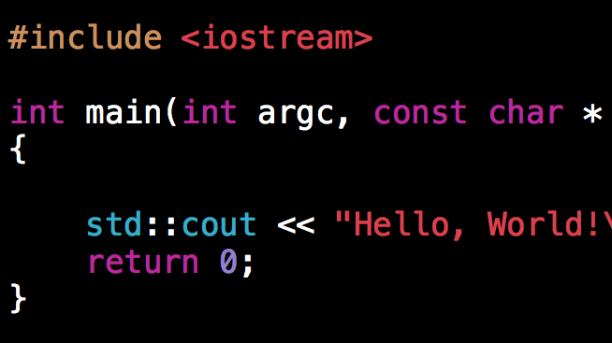
<THANKS FOR ATTENTION!/>

